Slide 1
PNC BANK P-CARD
TRANSACTION CODING AND EXPENSE REPORTING

Slide 2
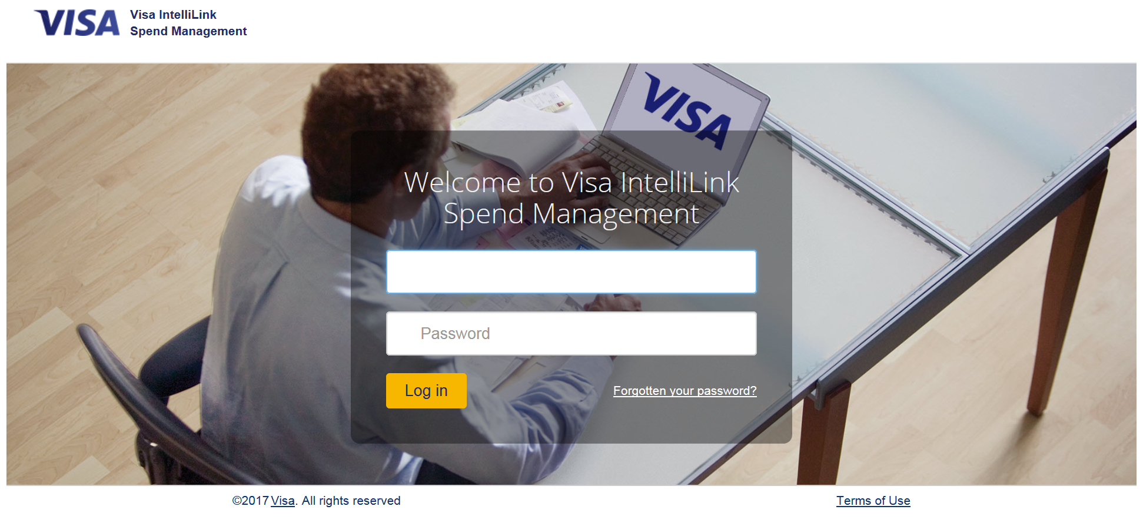
Go to Pcard Website
https://intellilink.spendmanagement.visa.com/secure/welcome.asp?logoff=1

Slide 3
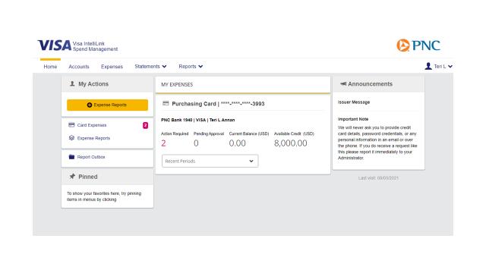
Select “Card Expenses”

Slide 4
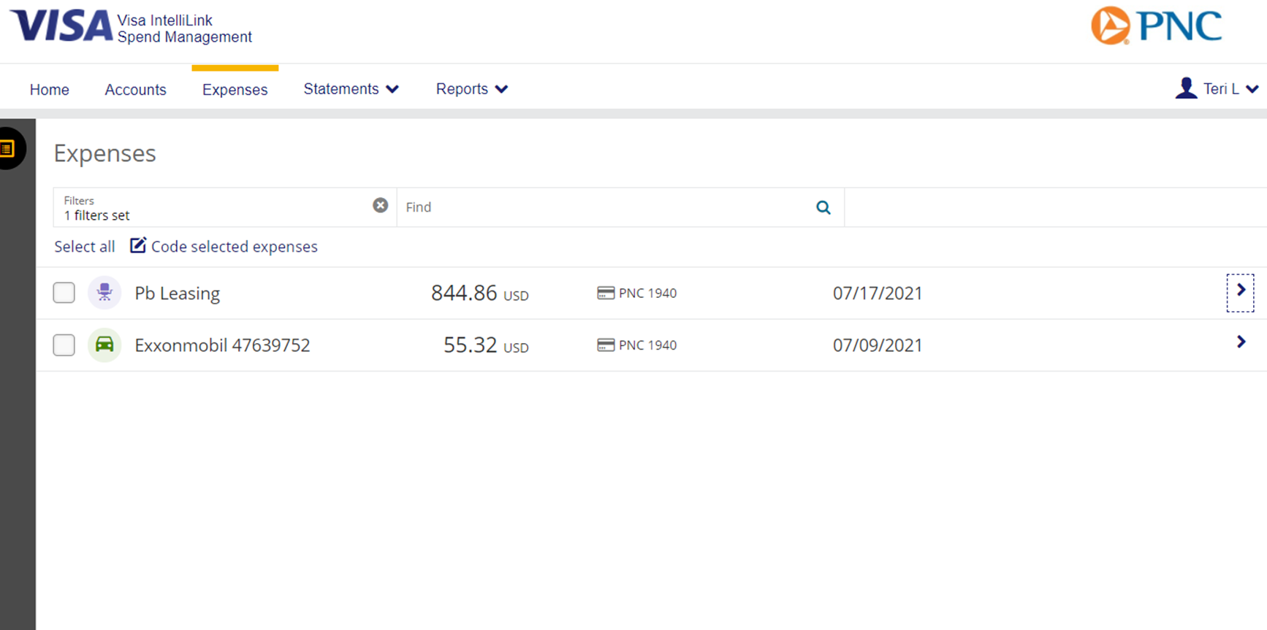
Click the arrow at the end of each charge.

Slide 5
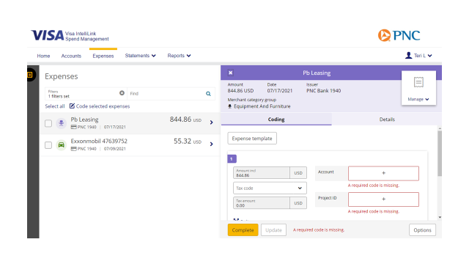
Click “+” to select Account Number and Project ID.

Slide 6
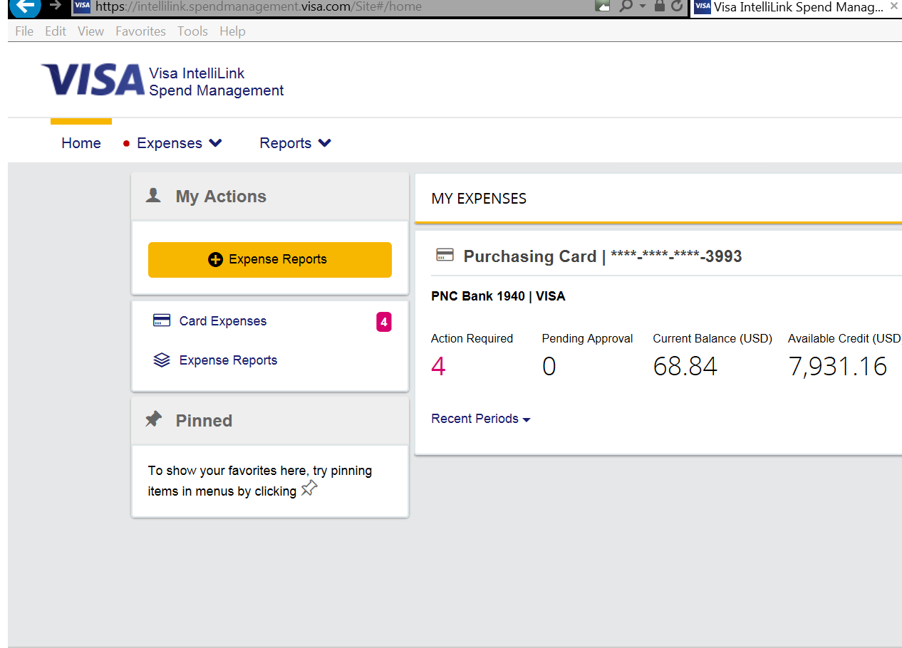
Select “Home.”
Select “Expense Reports.”

Slide 7
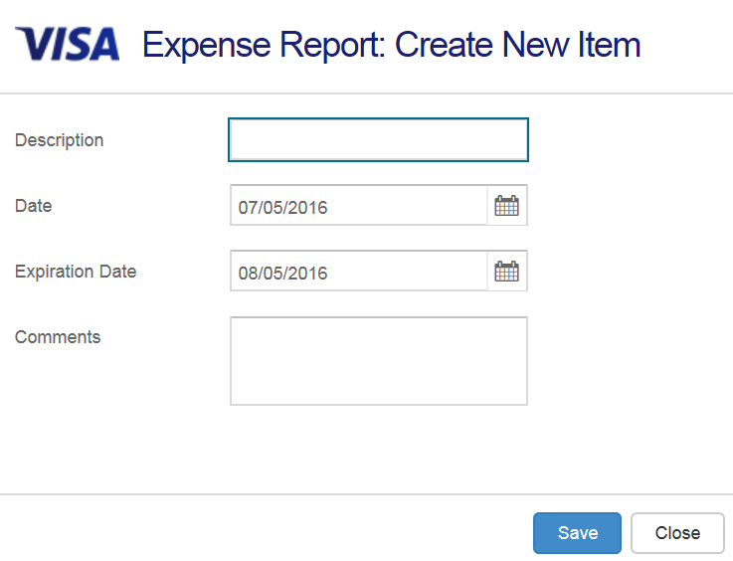
Enter report description.
Exp Rpt HuiA 2016-06
Click “Save.”

Slide 8
Select previous month.
Click “OK.”

Slide 9
Click “Select All.”

Slide 10
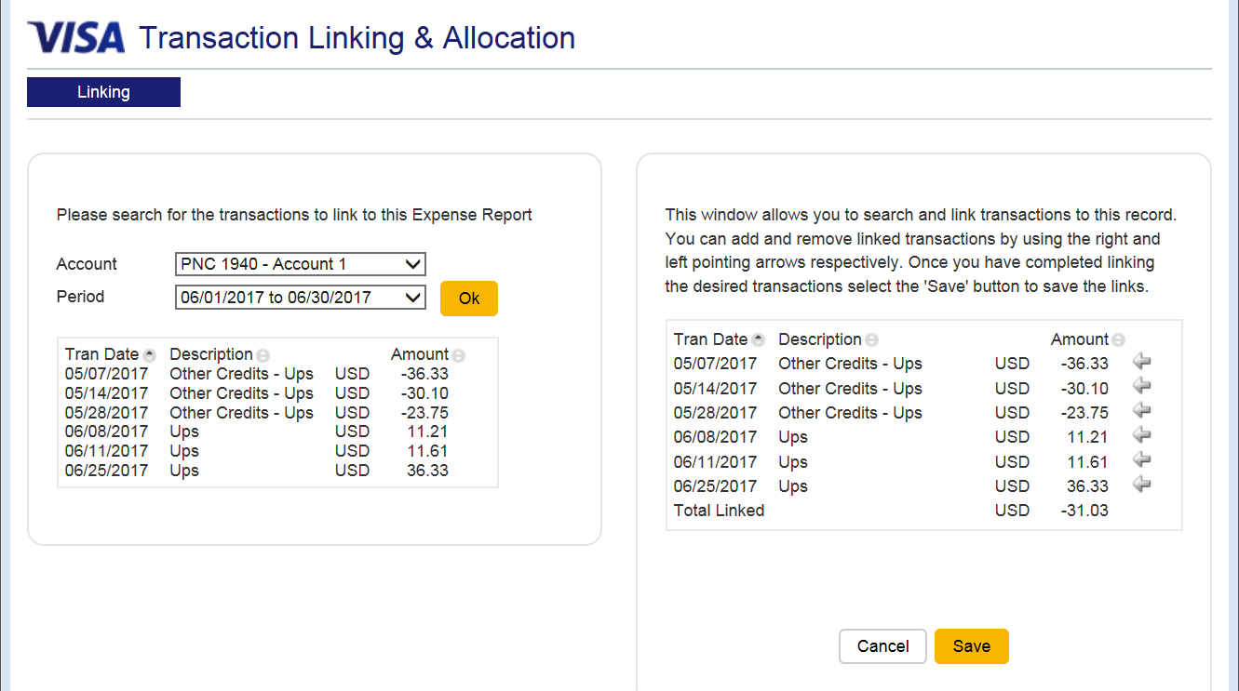
Click “Save.”

Slide 11
Click here to print expense report.

Slide 12
View and save the PDF file.

